Slide 1




IBM Technical Exchange DMN Going Beyond the Basics 24th May 2023
Reinhold Engelbrecht
Techsales Leader EMEA
IBM Business Automation
Nigel Crowther
RPA and Open Edition SME EMEA
IBM Business Automation
Fadi Sandakly
Decisions and Cloud Pak SME EMEA
IBM Business Automation
Material: https://ibm.box.com/v/2023-05DMNBeyondBasics

Slide 2

Agenda (times in CET)
09:30 – 09:35 Welcome 09:35 – 09:45 Why DMN (Presentation) 09:45 – 10:00 DMN Patterns (Presentation) 10:00 – 11:30 Lab 1-4 – DMN Patterns (Lab) 11:30 – 11:40 Comparison between ADS and DM
11:40 – 11:45 Hit policies (Presentation) 11:45 – 12:00 Lab 5 – Hit Policies (Lab) 12:00 – 12:20 Lab 6 Advanced Feel 12:20 – 12:30 Q&A and closing

Slide 3
Why DMN
What is DMN?
DMN stands for Decision Model and Notation. DMN is a modelling language for business rules.
Why use DMN?
DMN minimizes the risk of misunderstandings between business analysts and developers and allows the business to drive changes.
Standard
DMN is owned by an institution (OMG). OMG established standards such as BPMN and UML. The DMN standard is supported by many commercial products; DM, ADS, Camunda, DMN Modeller ..
Execution
DMN decision models can be executed. We will build and execute in KIE Sandbox
What is FEEL
FEEL (Friendly Enough Expression Language) is the underlying low code language for DMN
Notes:
https://ibm.ent.box.com/folder/207663729805?v=2023-05DMNBeyondBasics

Slide 4

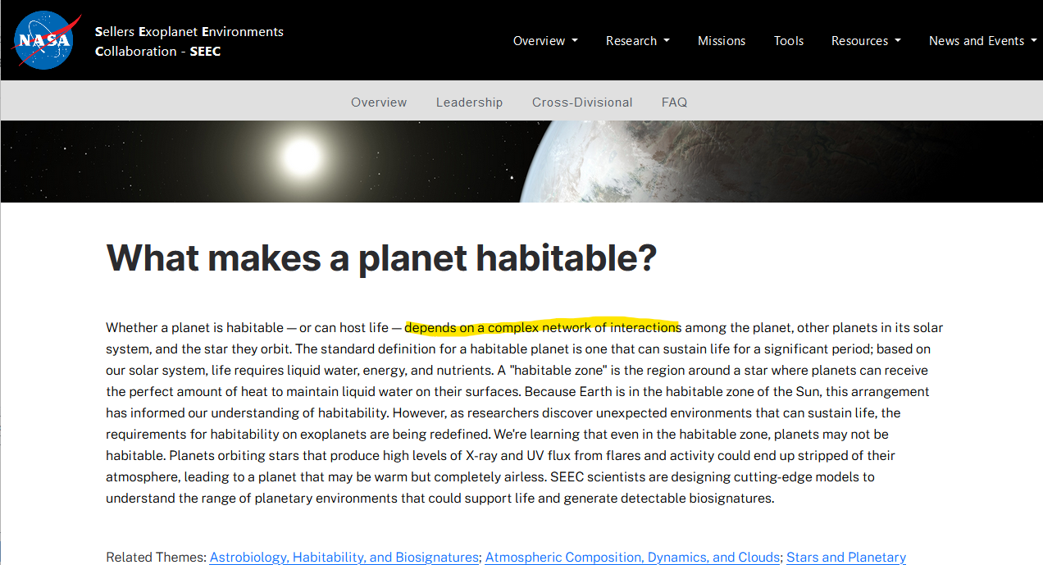
DMN Patterns – Planet Habitability Use Case
Notes:
https://ibm.ent.box.com/folder/207663729805?v=2023-05DMNBeyondBasics

Slide 5

DMN Patterns – Planet Habitability Use Case
Oxygen
Co2,
Methane
Max/Min Temp
Gravity
Air Pressure
Radiation
Eccentricity
Sunlight
Uninhabitable
Possibly habitable
Habitable
Notes:
https://ibm.ent.box.com/folder/207663729805?v=2023-05DMNBeyondBasics

Slide 6
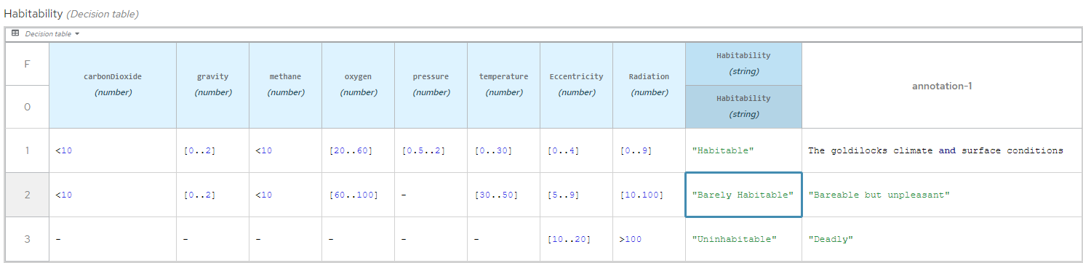
Single Wide Decision Table
Anti Pattern!
Notes:
https://ibm.ent.box.com/folder/207663729805?v=2023-05DMNBeyondBasics

Slide 7
Single Wide Decision Table
Anti Pattern!
Total rows = Number of condition cols * number of outcomes
24 = 8 * 3 [Habitability]
70000 = 700 * 100 [Insurance Segmentation rules]
Notes:
https://ibm.ent.box.com/folder/207663729805?v=2023-05DMNBeyondBasics

Slide 8
User IDs and Passwords for VM
Windows Server 2019: Administrator / IBMDem0s! Windows 11: .\techzone / IBMDem0s! IBM Business Manager Open Editions: bamAdmin / ibmpam1!

Slide 9
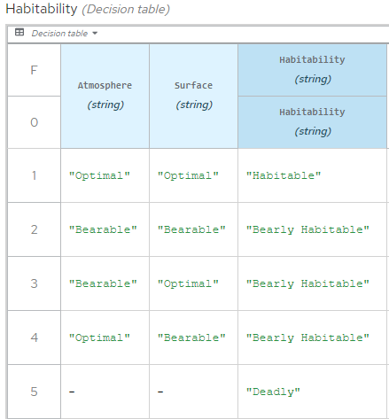
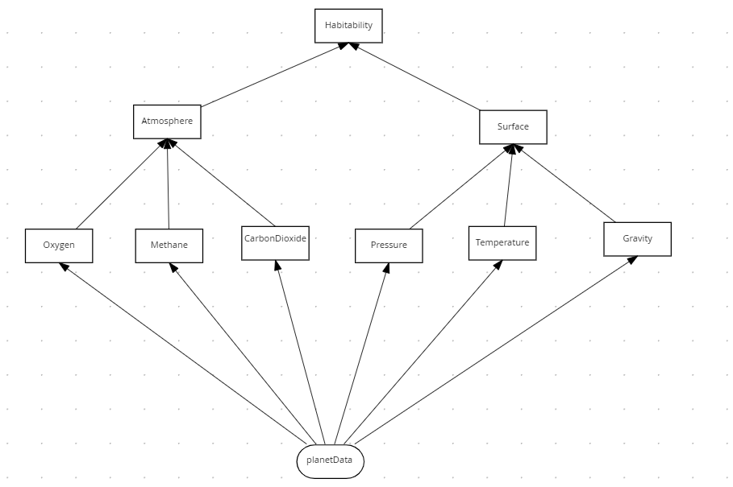
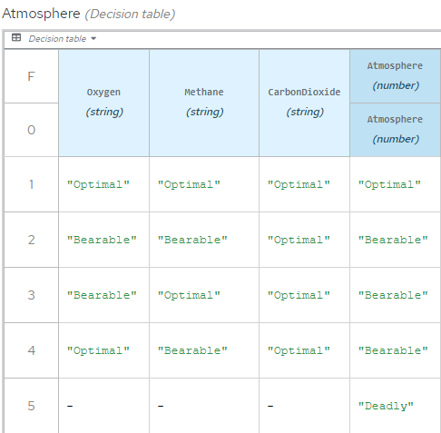
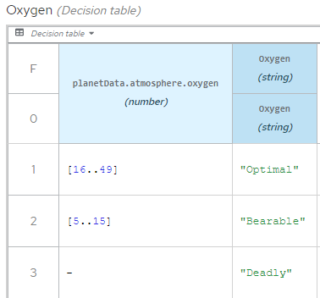
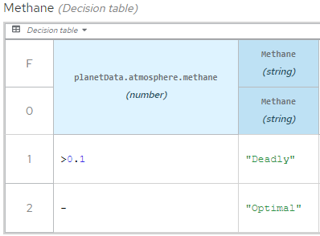
Divide and Conquer Pattern

Slide 10
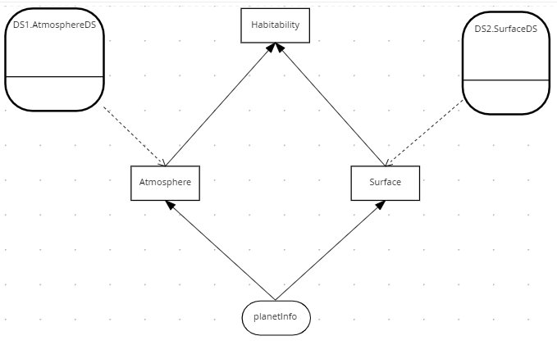
Tiered Service Pattern
The DMN defined in the previous lab was confined to a single file.
This is a problem because:
The DMN cannot be edited simultaneously by several people.
The DMN cannot be reused in other decisions.
The Tiered Service Pattern fixes this.
Decision
Service
Decision
Service

Slide 11

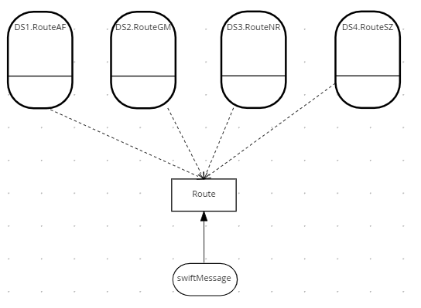
The Index Pattern
The Index Pattern
The Divide and Conquer Pattern does not work with many rules and few conditions. Use the Index Pattern for this.

Slide 12
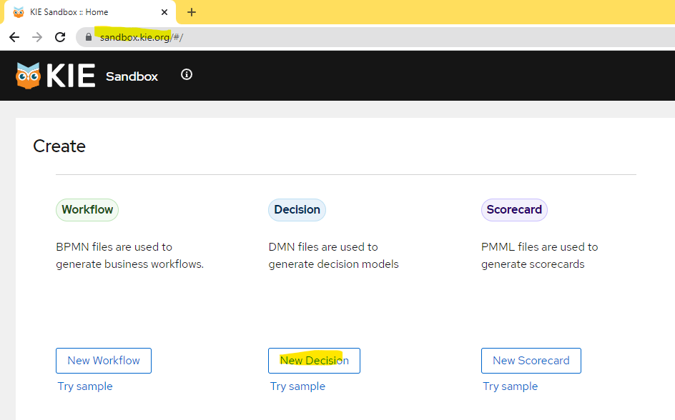
1. Let’s begin the hands-on part
Two pre-reqs
Chrome Browser: https://sandbox.kie.org
Install KIE Sandbox Extended Services. See Appendix A: Installing KIE Sandbox Extended Services
Lab guide (and other material)
https://ibm.box.com/v/2023-05DMNBeyondBasics
Any questions?

Slide 13
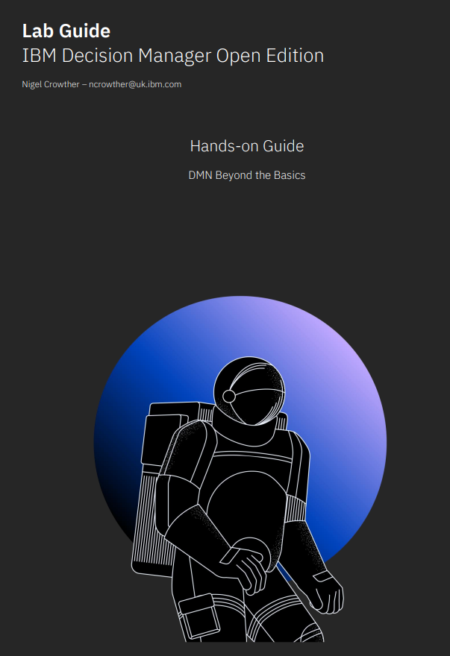
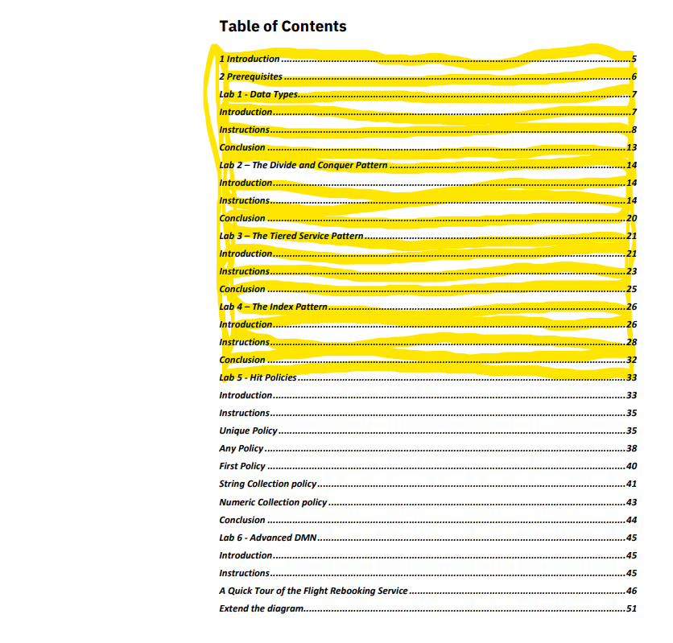
IBM Technical Exchange 10:00 – 11:30 Labs 1 to 4 - Patterns
In these labs you will learn real world patterns and techniques to build scalable and robust decision services.
Reconvene 11:30 CET

Slide 14
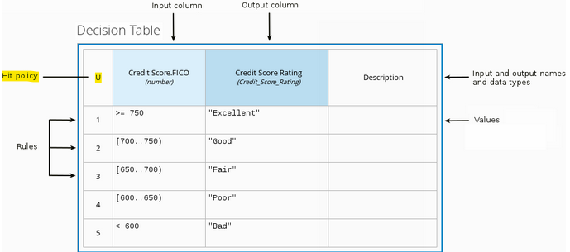
Hit Policies
Hit Policy | Description | When to use
Unique (U) | Permits only one rule to match. Any overlap raises an error. | For detailed reasoning. Ensures your rules cover all cases and are complete
Any (A) | Permits only one rule to match. But allows overlaps. | As above but less strict enforcement of overlaps
First (F) | Rules are evaluated from top to bottom. Rules may overlap, but only the first match counts. | For concise decision tables where a simple go / no go decision is needed rather than complete reasoning.
Collect (C) | Aggregates values in an arbitrary list. | For multiple row matches. String aggregator: <None> - matching instances returned as list Count – Matching instances counted Number aggregator: SUM – matching instances added Count – matching instances counted Min – minimum value Max – maximum value
Notes:
https://ibm.ent.box.com/folder/207663729805?v=2023-05DMNBeyondBasics

Slide 15
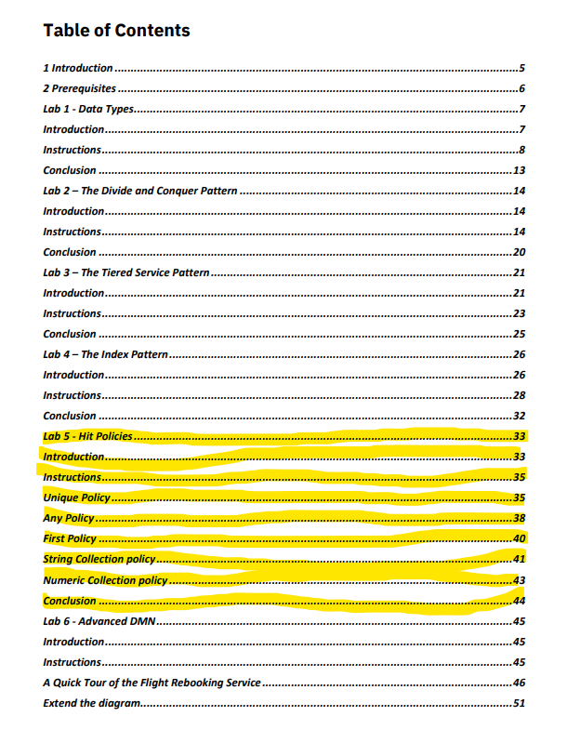
IBM Technical Exchange 11:30 – 12:00 Lab 5 - Hit Policies
In these labs you will learn about decision table hit policies
Reconvene 12:00 CET

Slide 16
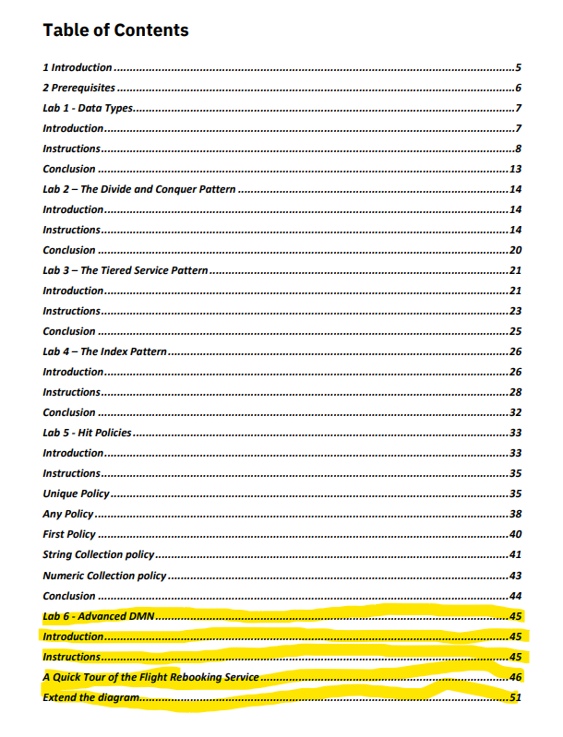
Lab 6
Demo

Slide 17
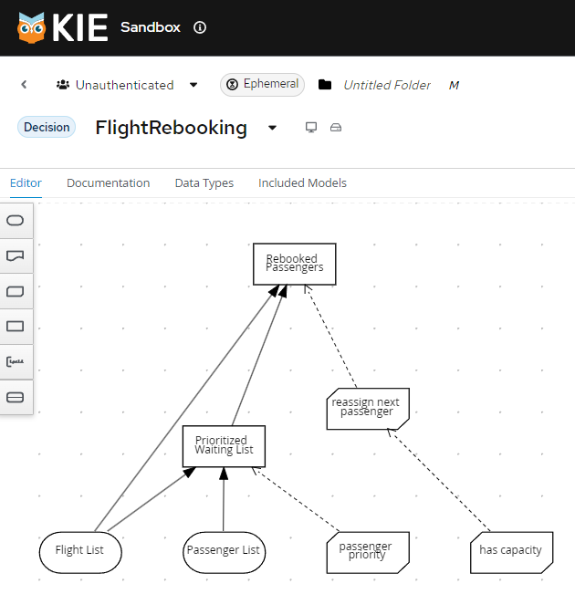
Lab 6 - Flight Rescheduling
Notes:
https://ibm.ent.box.com/folder/207663729805?v=2023-05DMNBeyondBasics

Slide 18
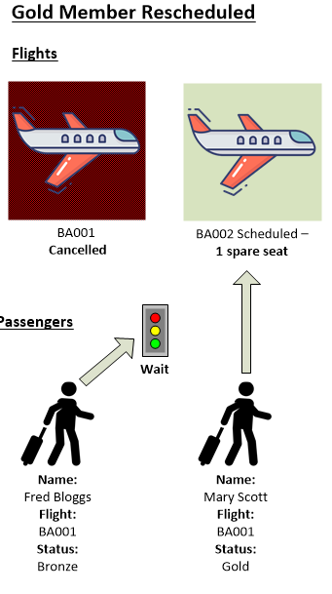
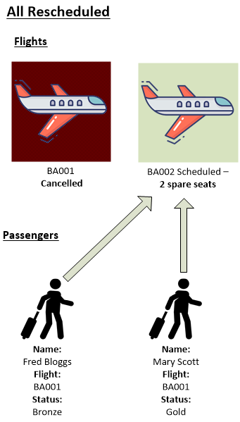
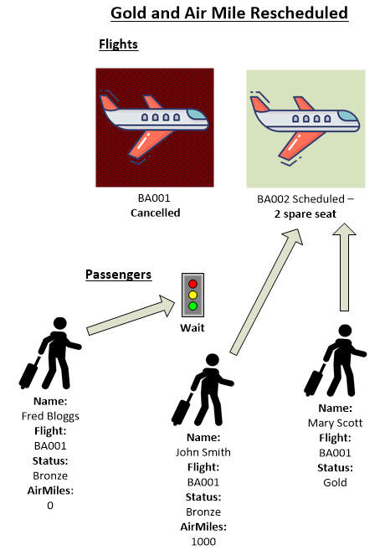
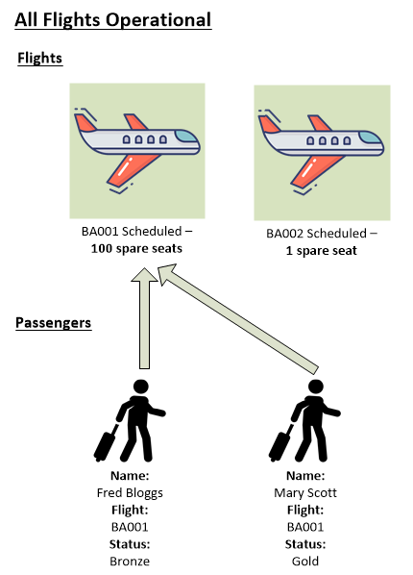
Flight Rescheduling scenarios

Slide 19

Q & A and Conclusion

Slide 20
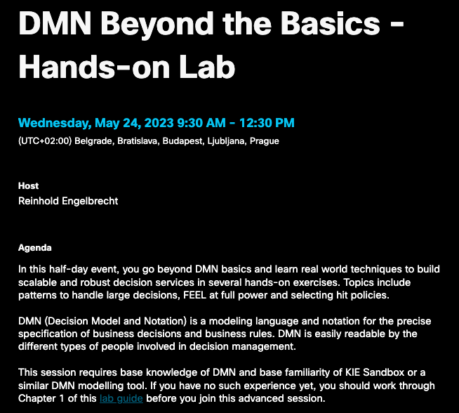
DMN Beyond the Basics – Hands-on Lab
For Clients and Partners!
Wed, May 24, 9:30-12:30 CEDT
–Registration

Slide 21

IBM Business Automation Community
Join now
Topic group
Open Edition
Forum, blog, articles …
Meet and interact with peers
Stay informed on new product developments
Ask for advice and guidance on a project
Recommend product enhancements
Participate in contests and hackathons
Pick up useful tips and tricks
Learn about upcoming automation events
Build a personal brand as a subject matter expert
Any questions?
Notes:
Finally, anyone can join the IBM Business Automation community to meet and interact with peers, stay informed on new developments, get advice and guidance on projects, recommend product enhancements, learn about upcoming events, and much, much more!
Reference:
Business Automation Community: https://community.ibm.com/automation

